Slide 1
DBMS-Presentation 2
By - Syed Hisham Azam
25WU0102282

Slide 2
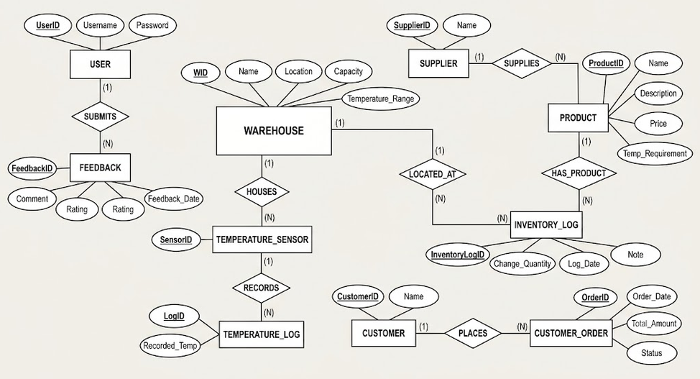
ER Diagram

